Slide 1

HIGH STRENGTH CONCRETE
Project Review-Phase 1
National Institute of Technology Nagaland
(An Institute of National Importance, Government of India)
Dimapur Nagaland-797103
Supervised by:
Dr. Pankaj Kumar
Assistant Professor
Dept. of CE
NIT Nagaland
Presented by:
Ahwang L Konyak (2020101105)
Avinash Kumar (2020101111)
Peeyush Katiyar (2020101127)
Suman Saurabh (2020101133)

Slide 2
INDEX
Introduction
Concrete
Special Purpose of Concrete
Types of Special Purpose concrete
High Strength Concrete
History of high strength concrete
Difference between normal concrete and high Strength Concrete
Application of High Strength Concrete
Advantage and Disadvantages of High Strength Concrete
Factors affecting strength of concrete
2. Literature review
3. Research gap
4. Aims and objective
5. Conclusion
6. Reference

Slide 3
CONCRETE
Consists primarily of cement, water and aggregates such as sand and gravel.
Utilized due to its strength, durability and adaptability to different shape and forms.
Essential component of construction
Most widely used building material.

Slide 4
SPECIAL PURPOSE CONCRETE
Demand for variety of concrete types.
Designed to meet that particular requirement.
Exhibit enhance strength, durability, workability or resistance.
SOME TYPES OF SPECIAL PURPOSE CONCRETE
High strength concrete- Superior compressive strength
Ferrocement concrete- Crack Fighter
Fiber reinforce concrete- Shrinkage fighter
Polymer impregnated- void Fighter
Self compacting concrete- Compaction without Vibrator
Prestress concrete- Fast construction

Slide 5
HIGH STRENGTH CONCRETE
High strength concrete has compressive strength more than 40 MPA
Low Water cement ratio is a Crucial
HISTORY OF HIGH STRENGTH CONCRETE
Concrete with a compressive strength of 34MPa in the 1950s.
Early 1970s witnessed the production of 62MPa Concrete.

Slide 6
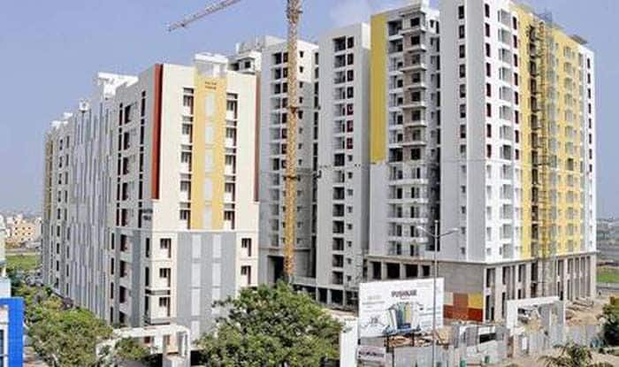
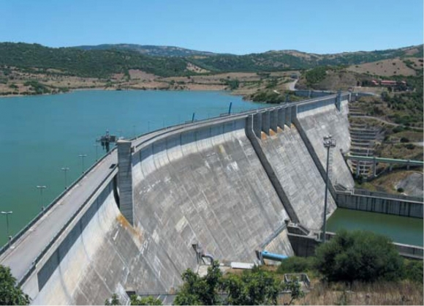
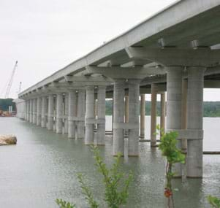
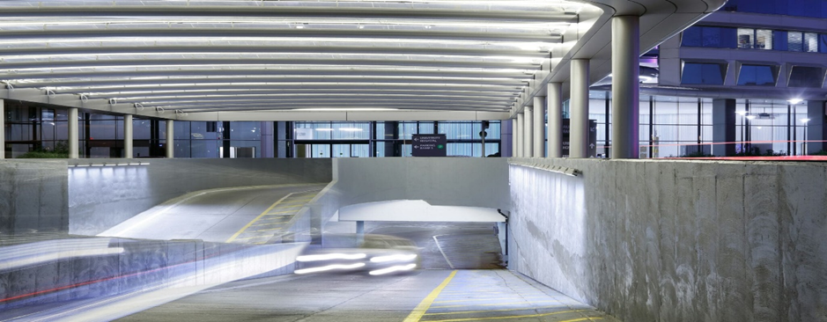
APPLICATION OF HIGH STRENGTH CONCRETE
High rise building Dams and reservoir
Bridges Parking structure

Slide 7
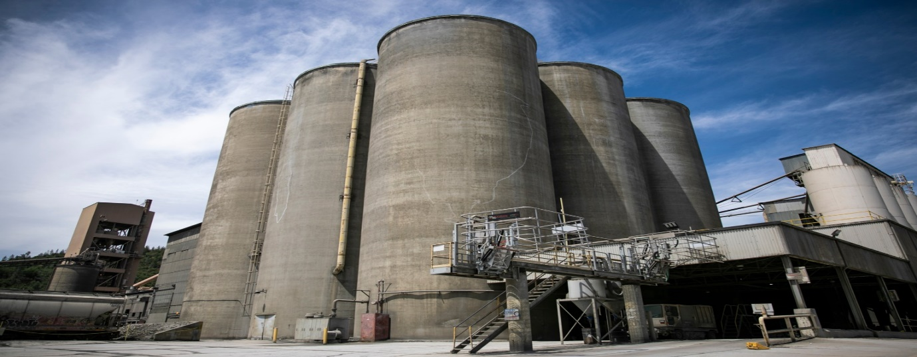
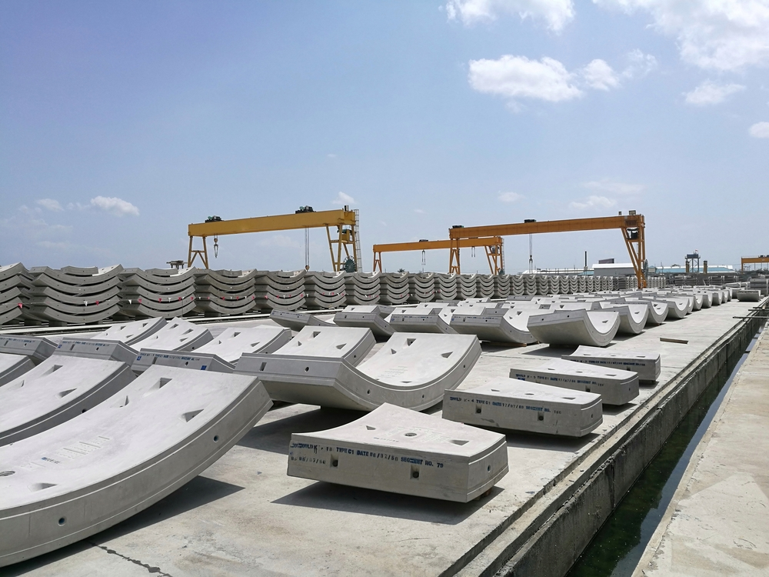
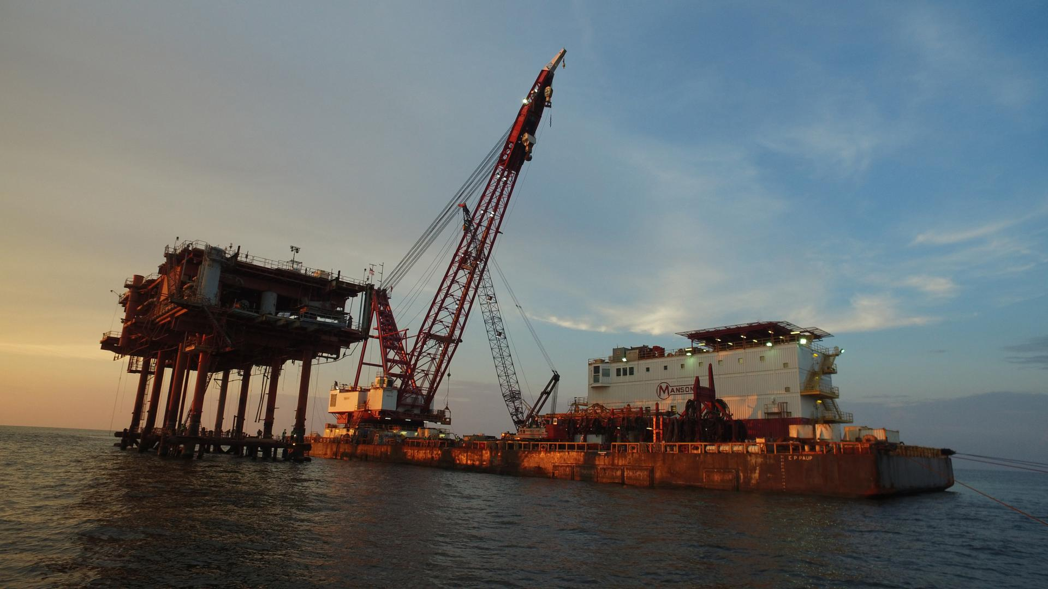
APPLICATION OF HIGH STRENGTH CONCRETE
Industrial structure Precast concrete elements
Marine structure

Slide 8
ADVANTAGE OF HIGH STRENGTH CONCRETE
Increase load bearing capacity.
Long term cost saving.
Better resistance to fire.
Potential for thinner section.
Improve structure performance.
DISADVANTAGE OF HIGH STRENGTH CONCRETE
Higher cost.
Complex quality control.
Reduced workability.
Limited Availability of materials.
Temperature sensitivity.

Slide 9
FACTORS AFFECTING HIGH STRENGTH CONCRETE
Characteristics and proportioning of materials.
Curing conditions.
Degree of compaction.

Slide 10
DIFFERENCE BETWEEN ORDINARY CONCRETE AND HIGH STRENGTH CONCRETE
Sl.no | Ordinary Concrete | High Strength Concrete
1. 2. 3. 4. 5. | Economic Strength and durability is low Typical Construction work Formal Method is used High water cement ratio | Expensive Strength and durability is high High rise structures and radiation protection plant. High skill technique is used Low water cement ratio

Slide 11
LITERATURE
SL.NO. | AUTHOR | YEAR | TITLE OF PAPER | FINDINGS
01. | Sernas et al. | 2020 | “Effect of silica fuel on high strength concrete performance” | Studies how adding silica fume to high-strength concrete affects its performance for road pavement. Study suggests that 7% silica fume is optimal.
02. | Thaguna et al. | 2023 | To determine the strength of concrete with partial replacement of sand with marble dust powder | Using waste marble dust powder as a substitute for sand in concrete production to enhance sustainability. The best compressive strength was at 30% marble dust replacement for sand.
03. | F.A Memy, Abdul manan Yous Fani | 2017 | Effect of marble dust replacement of cement on fresh and hardened properties of concrete | Study explored using waste marble from landfills as an eco-friendlier solution. 5% replacement is the optimal content.
04. | Neha Singh, Rahul Kumar | 2023 | Experimental analysis of partial replacement of ordinary Portland cement in concrete with superplasticizer and marble dust | Study explore replacing cement with materials like marble dust in concrete production. Best results were seen with 15% cement replacement and 1.5% super plasticizer.

Slide 12
LITERATURE
SL.NO. | AUTHOR | YEAR | TITLE OF PAPER | FINDINGS
05. | Ali et al. | 2021 | Effect of recycled coarse aggregate from concrete debris on the strength of concrete | Explores using recycled materials from demolished buildings in Iraq and crushed concrete cubes from the laboratory. Results revealed that recycled concrete from demolished buildings had lower strength, while recycled cubes from the lab had higher strength compared to regular concrete
06. | Sathiaseelan et al. | 2021 | Fly ash as mineral admixture in concrete mix. | Explores using fly ash instead of some cement in concrete. Adding 10% fly ash to cement increases the compacting factor by 4% for every 10% addition.
07. | Okechukwu opi kingsluy, Boniface Adinna | 2023 | Strength and workability of concrete with inclusion of fly ash quarry dust and a generic naphthalene based superplasticizer | The research enhances concrete strength and workability by incorporating fly ash, quarry dust, and superplasticizer (SNFC), reducing water content. 10% replacement of cement with fly ash Was optimal.
08. | Nguyen DUC Uinhquang, Boris Bulgakov | 2023 | High performance concrete produced with locally available materials | Utilizing local materials like fly ash and silica fume for strengths. 10% replacement of silica fume with 20-40% fly ash proved to be the optimal choice for top-notch concrete properties.

Slide 13
LITERATURE
SL.NO. | AUTHOR | YEAR | TITLE OF PAPER | FINDINGS
09. | Dhanada Mishra, Christoper ky leong | 2017 | Very high volume of fly ash green concrete for application in India. | Study explores a new type of eco-friendly concrete, known as green concrete, has been developed by replacing 80% of traditional cement with fly ash. Result shows significant reductions in environmental impact and material costs compared to regular concrete.
10. | Balestra et al. | 2018 | curing environment on the strength of concrete | Studies how different curing conditions affect the strength of concrete paper highlights that fully saturating concrete in water leads to better compressive strength.
11. | Mohammad Abdur Rashida and Mohammad Abul Mansur | 2008 | Considerations in producing high strength concrete | The paper reviews strategies for making high-strength concrete (HSC) emphasizing quality materials, low water content, and specific admixtures. Even with standard materials, HSC with strengths up to 127 MPa is possible.
12. | S.M. Gupta, V.K. Sehgal, S.K. Kaushik | 2009 | Shrinkage of high strength concrete | Study on High Strength Concrete (HSC) with fly ash and silica fume. When 10% of cement is replaced with fly ash and silica fume, the concrete shows higher shrinkage strains (6 to 10%) compared to concrete without these additives.

Slide 14
LITERATURE
SL.NO. | AUTHOR | YEAR | TITLE OF PAPER | FINDINGS
13. | Saifuddin et.al | 2009 | Material reference of high strength high performance concrete | Role of water reducers and air-entraining admixtures in achieving high-strength. Enhanced performance of high-performance concrete (HSHPC) by incorporating optimal amounts of high-range water reducers and air-entraining admixtures.
14. | Poornima Patil, Kushal Kapali A | 2018 | High strength concrete without Cementitious admixtures. | Project aims to create robust concrete (grade M55) without GGBS or silica fume, utilizing a new superplasticizer. Replacing 15% of cement with silica fume, achieving the best results.

Slide 15
RESEARCH GAP
The cost of high strength concrete construction are much more expensive. Their has not been much exploration on the cost optimization aspects.
There is no specific optimal ratios of the concrete mix to achieve maximum strength and enhance the properties of concrete.
There is a lack on non destructive testing techniques for assessing the quality in performance of high strength concrete.
There is not much technique in methods of quality control and monitoring of high strength concrete during construction to ensure consistency any reliability.

Slide 16
RESEARCH GAP
There is no standardize mixed design available for high strength concrete and trial and error method is employed.
When comparing to a normal concrete the weight of high strength is high. The development of high strength but light weight concrete is ongoing but not much progress has been made.
There has not been much exploration on the use of waste material such as recycle aggregates or industrial by products in high strength concrete.
There is not much exploration on the use of alternative materials and producing methods to reduce the impact of environment.

Slide 17
AIMS AND OBJECTIVE
AIMS
The aim of our project is to produce a high strength concrete- greater than 80 Mpa by using proper proportions of materials and various admixtures
OBJECTIVES
To learn the effect of admixtures on the development of high strength concrete
To study the factors affecting the strength of concrete
To achieve a concrete mix of strength greater than 80 Mpa

Slide 18
CONCLUSION
In summary, our high strength concrete project filled a gap in our knowledge about construction materials by focusing on making concrete tougher. We saw the need for stronger and more durable buildings and learned how to improve concrete mixtures using advanced materials.
Finding this gap showed us why it is crucial to keep exploring and innovating in construction materials. Even though our project did not give results, it set our goal for future research. By recognizing the gap, we dig deeper into high-strength concrete, to find better and more eco-friendly solutions.
In simple terms, our project matters not just for what we found now but for inspiring us for further research and improvement in how we understand and make materials for long-lasting and strong buildings. Looking ahead, we plan to keep addressing these gaps to boost our knowledge and enhance the performance of materials that are crucial for sturdy and resilient infrastructure.

Slide 19
REFERENCES
Memon, F. A., A. M. Yousfani, D. K. Ladher, and N. Jarwar. "Effect of Marble Dust as a Partial Replacement of Cement on Fresh and Hardened Properties of Concrete." In Proceedings of the International Conference on Sustainable Development in Civil Engineering, Jamshoro, Pakistan, pp. 23-25. 2017.
Ludovic, V. S., R. V. Lesovik, and WS Albo Ali. "Effect of recycled coarse
aggregate from concrete debris on the strength of concrete." In Journal of Physics: Conference Series, vol. 1926, no. 1, p. 012002. IOP Publishing, 2021.
Obi, Okechukwu K., and Okafor B. Adinna. "Strength and Workability of Concrete with Inclusion of Fly Ash, Quarry Dust and a Generic Naphthalene-based Superplasticizer." (2023).
Bulgakov, B. I., V. Q. D. Nguyen, A. V. Aleksandrova, O. A. Larsen, and N. A. Galtseva. "High-performance concrete produced with locally available materials." Magazine of Civil Engineering 1 (117) (2023).
Rashid, Mohammad Abdur, and Mohammad Abul Mansur. "Considerations in producing high strength concrete." Journal of Civil Engineering (IEB) 37, no. 1 (2009): 53-63.

Slide 20
REFERENCES
Gupta, S. M., V. K. Sehgal, and S. K. Kaushik. "Shrinkage of high strength concrete." International Journal of Mechanical and Mechatronics Engineering 3, no. 2 (2009): 154-157.
Sathiaseelan, Brindha & Hannahangelin, Mrs & Sathiaseelan, P & Affiliations, Author. (2022). Fly Ash as Mineral Admixture in Concrete Matrix -A State of the Art. Journal of Environmental Protection and Ecology.
Kumar, Rahul & Singh, Neha. (2023). Experimental Analysis of Partial Replacement of Ordinary Portland Cement in Concrete with Super plasticizer and Marble Dust. International Research Journal of Engineering IT & Scientific Research. 09. 527.
Safiuddin, Md & Islam, Md & Zain, M. & Mahmud, Hilmi. (2009). Material aspects for high-strength high performance concrete. International Journal of Mechanical and Materials Engineering.
Patil, Poornima & A, Kushal. (2018). High Strength Concrete without using Cementitious Admixtures. International Journal of Engineering Research and. V7. 10.17577/IJERTV7IS0100.

Slide 21
REFERENCES
Junior, R. A., M. G. Lima, and Carlos Eduardo Tino Balestra. "Influence of Distinct Curing Environments on the Compressive Strength of Concrete." Journal of Engineering, Project, and Production Management 8, no. 2 (2018): 56.
Mishra, Dhanada Kanta, Jing Yu, and Christopher Kin Ying Leung. "Very high-volume fly ash green concrete for application in India." Global Waste Management (2017): 480.
Gražulytė, Judita, Audrius Vaitkus, Ovidijus Šernas, and Donatas Čygas. "Effect of silica fume on high-strength concrete performance." In 5th World Congress on Civil, Structural, and Environmental Engineering (CSEE’20), vol. 162, pp. 1-6. 2020.
Devi, Rajkumari Themisana, Abhilash Thakur, Parwati Thaguna, Anuradha Thounaojam, and Amenjor Senagah. "TO DETERMINE THE STRENGTH OF CONCRETE WITH PARTIAL REPLACEMENT OF SAND WITH MARBLE DUST POWDER."

Slide 22
THANK YOU

